Slide 1
Inha University in Tashkent
Theme 3: Early Middle Ages Philosophy in Central Asia

Slide 2
Outline:
Principles and Main Branches of Islam
Arab Invasion of Central Asia
Sufism
Scholars of Middle Ages and Their Role in Development of Sciences

Slide 3
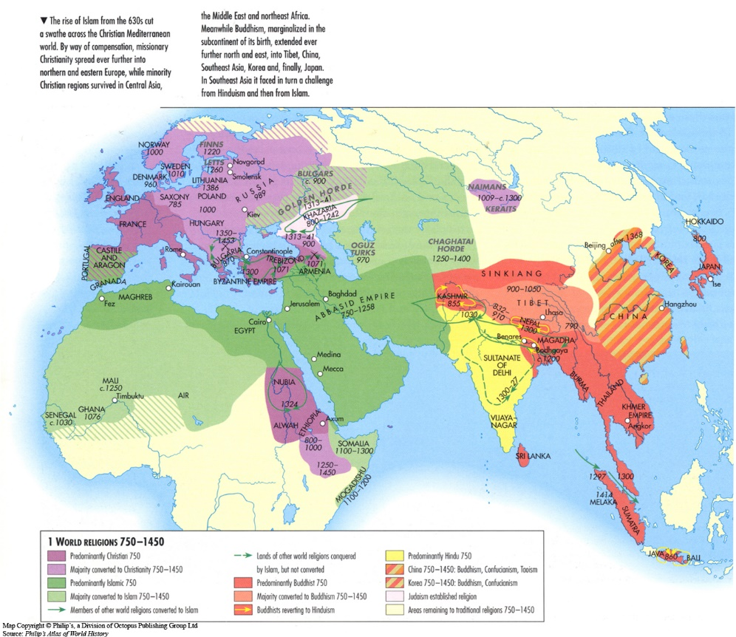

Slide 4
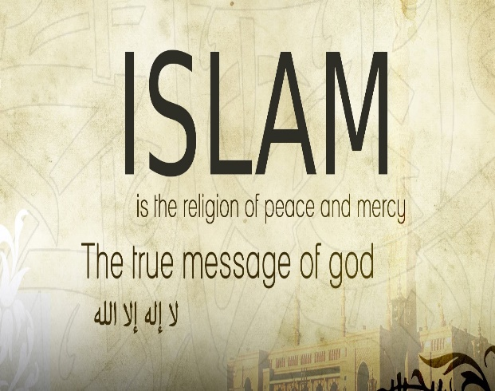
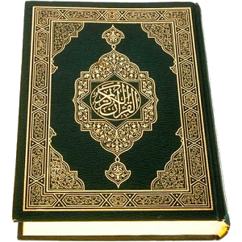
Islam and Its Principles
Islam is an Arabic word meaning self-submission to God, obedience, and peace
Qur'an is a holy book, believed to be the word of God as dictated to Muhammad by the archangel Gabriel and written in Arabic. It contains Islamic traditions, beliefs, legal and moral principles. Qur'an consists of 114 units (surahs) and several verses (ayats).
Sunnah is a collection of hadiths. The Prophet Muhammad's words and actions are summarized in the form of hadiths. Hadiths are the primary source after the Qur'an.
The Shari'ah is Islamic canonical law, and it based on the teachings of the Koran and the traditions of the Prophet (Hadith and Sunna) and also other important sources. The Shari’a is a system of legal, ethical principles and practical requirements in Islam.

Slide 5
The Pillars of Islam
There are five basic religious acts in Islam, that known as 'The Pillars of Islam' (arkan al-Islam; also, arkan ad-din, "pillars of religion"), which are considered obligatory for all believers, i.e. muslims:
the creed (shahadah)
daily prayers (salat)
almsgiving (zakat)
fasting (during Ramadan)
the pilgrimage to Mecca (hajj) at least once in a lifetime.

Slide 6
The Branches of Islam
The main branches of Islam are Sunnis, Shiahs, and Khawarijs (Kharijites).
Khawarijs are members of the group that appeared in the first century during the First Fitna, the crisis of leadership after the death of Muhammad (May God honor him and grant him peace). Khawarijs were divided into many subdivisions in the Middle Ages and then disappeared. Only the Ibodis survived as a branch and remainder of Khawarijs.
Sunni and Shia sects differ from each other in terms of authority (Sunni – caliphate, Shi'ism – imamah), religious ceremonies and traditions. The Sunni branch of Islam stipulates that, as a head of state, a caliph should be elected by Muslims or their representatives. Followers of Shia Islam believe a caliph should be an Imam chosen by God from the Ahl al-Bayt (“Family of the House”, Muhammad’s direct descendants).
There are some sects in Shi’ism: Karmats, Ishmaelites, Zaidids and others. Shiites recognize the Koran as divine; they accept the hadiths related to Ali and recognize the imam's authority (imamah). Shiites make up around 10 percent of the world's Muslims.
Sunnism is a world-wide sect, with about 90% of Muslims. There are four main legal schools in Sunnism: Hanafi, Shafi’ite, Malikite and Hanbalite.

Slide 7
Arab Invasion of Central Asia
Under the flag of Islam, Arabic tribal groups united in a vast territory, with a single centralized Arab caliphate. During the medieval and modern periods four major caliphates existed:
1) Rashidun Caliphate (632-661)
2) Ummayad Caliphate (661-750)
3) Abbasid Caliphate (750-1258)
4) Ottoman Empire (1517-1924)
Along with the Arab invasion, Movarounnahr also embraced Islam
The Arab conquest of Central Asia can be divided into two historical periods. In late of the seventh century Arab troops captured southern part of Central Asia, such as Balkh, Chaghaniyon, Marv. During early of the eighth century Arab army under command of Qutayba ibn Muslim conquered Kesh, Samarqand, Tashkent, O’sh, Eastern Turkestan.

Slide 8
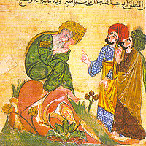
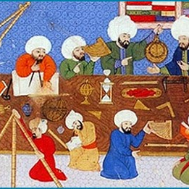
Islamic Philosophy
The Islamic Golden Age is the era in the history of Islam, traditionally dated from the 8th century to the 13th century, during which economic development and cultural works flourished.
This period is begun during the reign of the Abbasid caliph Harun al-Rashid (786 - 809) who established House of Wisdom in Baghdad, where scholars from various parts of the world with different cultural backgrounds were mandated to gather and translate all of the world's classical knowledge into the Arabic language.
Early Islamic philosophy began in early 9th century and lasted until late 12th century AD. The achievements of this period had a crucial impact on the development of modern philosophy and sciences, for Renaissance Europe.
Islamic tradition influenced on all sphere of cultural life in Central Asia.

Slide 9
Motrudi
His books, titled " Kitab at-tawhid" and "Kitab ta'vilot al-Qur’an", are of great importance among the scholars.
According to Moturidian teachings – Allah, man, faith, universe, science are the dominant positions. He tried to justify religious beliefs. He relied on the Koran and tried to justify the existence of Paradise and hell, the limited presence of free will in man, but to assume that man is responsible for his actions before God. This spiritual process is accompanied by Islamic and philosophical views of Aristotle's and his followers (Aristotle's philosophy and those who have agreed to the study of nature).
In the tradition of ancient Greek philosophy, political activity and wisdom are often viewed as contradictory, and in Islamic philosophy it is seen as a form of human activity, rather than politics. Management of the state in Islam is art, but it must be adhered in the process of social justice, and that social justice can be stable because of the adherence to equality. According to Islamic philosophy, the future of humanity is shaped by the formation of a perfect human, and morality is an indispensable part of human thought. The Islamic Intellectuals have an interest in the mind and logic, because any knowledge that is not based on logic cannot be reliable and effective.

Slide 10
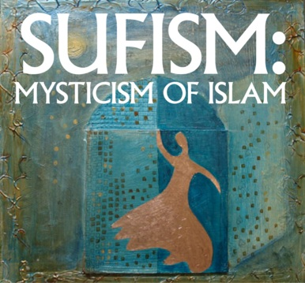
Sufism
Sufism (or Tasawwuf) is often defined as “Islamic mysticism”. Practitioners of Sufism are called “Sufis”.
There are different orders (turuq) in Sufism.
One of main issues of Sufism is dhikr performance, the practice of remembrance of God.
There are three main Sufi orders that were originated and developed by Central Asian scholars: Yassawi, Kubrawi and Naqshbandi.

Slide 11

Yassawiya Order
Khoja Ahmad Yassawi is the founder of Yassawi order, and he was born in Sayram in 1093 and died in 1166 in Turkestan city.
The basics of Yassawi are as follows:
Sufi concepts based on Tawhid (oneness of God);
absolute dependence on Qur’an and the Sunnah;
the order that based on Sharia;
sedate (khilwa) and remembrance.
In Yassawi, special attention was paid to the acquisition of knowledge, generosity and the struggle against the ego (nafs), and the provision of halal labor. The Yassawi zikr is based on vocal performance. According to Sufism, the true origin of man is universe. Human beings must be brought back to this sacred universe.
According to majority scholars, Ahmad Yassawi is the author of “Yassawi hikmatlari”.

Slide 12
Kubrawiya Order
Najmiddin Kubra (1145-1221), the founder of the Kubraviyya Sufi order. He was born in Khiva. Kubra's main body of works concerns the analysis of the visionary experience.
He wrote numerous important works discussing the visionary experience, including a Sufi commentary on the Quran that he was unable to complete due to his death in 618/1221. Among the works, "Sharhus-sunna val-masolih", "Usuli ashara", "Favoihul-jamol" are popular.
The essence of Kubraviyya is embodied in these ways.
1) Facing to God by his/her will
2) To abstain from all kind of tastes.
3) To gain the satisfaction of God
4) To love the truth
The Kubrawiya was not largely popular until after Kubra's death in the 13th century. The Kubrawiya found great development outside of Central Asia, but its influence and presence only lasted till the 15th/16th century, when it was overshadowed by the Naqshbandiya during the Ottoman Empire, though some nominal followers survived. Kubra died during the Mongol invasion.

Slide 13
Naqshbandiya Order
Bahauddin Naqshband (1318–1389) was the founder of the Sufi Naqshbandi Order. He was born in the village of Qasr-i-Hinduvan near Bukhara.
The essence of this doctrine is clearly illustrated in the slogan "Dil ba yoru dast ba kor” which literally means – "Heart with God, and hands in labor".
Man is the result of the grace of Allah and should not forget the world, his heart should always be in Allah, and His hand should be in labor. According to Naqshbandi teaching, Muslims should repeat always the dhikr orally and mentally.

Slide 14
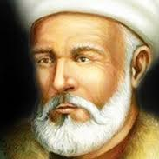
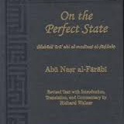
Al-Farabi
Al-Farabi (873-950) was prominent scholar who studied in fiqh, methaphysics ethics, logics and political philosophy.
He is considered as “the Second Teacher” in Islamic philosophical tradition.
He was invited to Baghdad and contributed to the development of sciences
Al-Farabi’s key work – ‘al-Madina al-fadila’ (‘The Virtuous City’)
He regarded philosophy as the only route to true knowledge.
‘Philosophers have a duty to guide people in all matters of daily life’
He described a Platonic utopia in his work ‘al-Madina al-fadila’

Slide 15
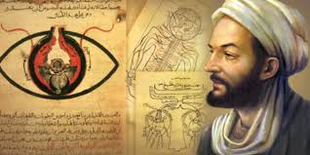
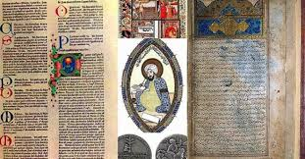
Ibn Sina
Ibn Sina was born in the village of Afshona near Bukhara. He was a great polymath – astronomer, physician, philosopher and outstanding representative of medical sciences.
He was well-known in the West by the name of Avicenna.
He spent his early time in the Court of Samanids.
He is the author of more than 200 works. Major works – “Books of Healing”, “Canon of Medicine”.
He was interested in Islamic theology, mathematics, physics, psychology, logic and so on.
Ibn Sina was the adherent of Aristotle and followed Greek wisdom and methods of reasoning and proof.
According to him the soul is distinct from the body.

Slide 16
Thank you for your attention!

